Slide 1
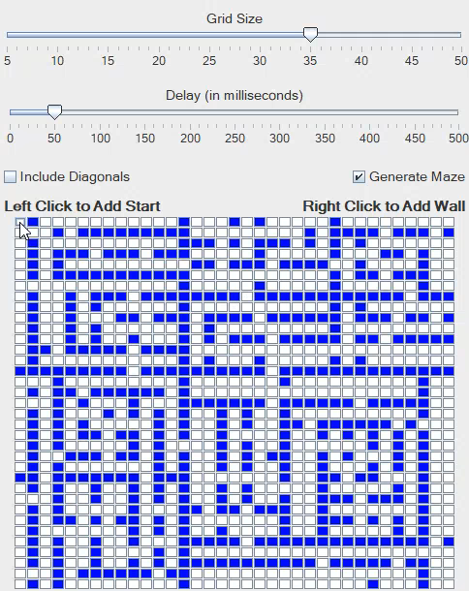
CPSC 223J Final Project By: Jalen Jackson
Pathfinder

Slide 2
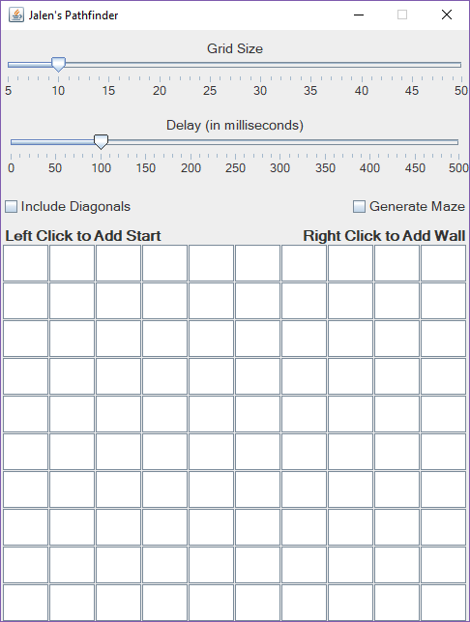
Jalen’s Pathfinder By Default
Grid Size = 10 cells
Delay = 100 ms
No Diagonal Paths
No Mazes Generated
All Empty Cells

Slide 3
Step One
Pick the starting point

Slide 4
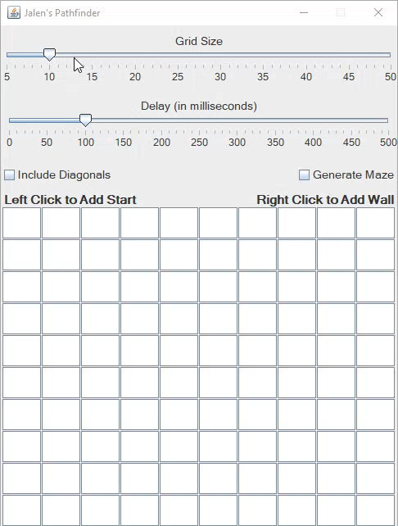
Picking the Starting Point
Left Click on Empty Spot
Turns to Starting Point
Left Click on Starting Point
Reverts to Empty Spot

Slide 5
Step Two
Pick the end point

Slide 6
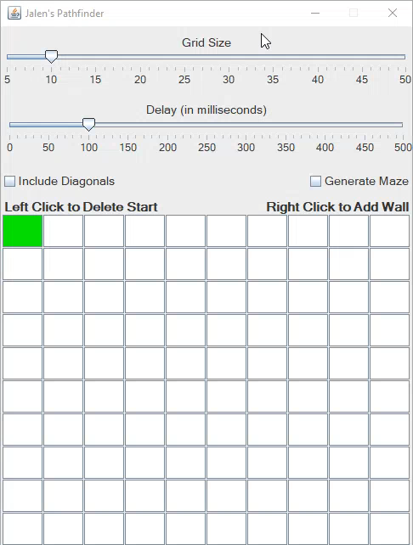
Picking the End Point
Left Click on Valid Spot
Turns to end point
Draws shortest path between start & end points
End point is now starting point after path drawn

Slide 7
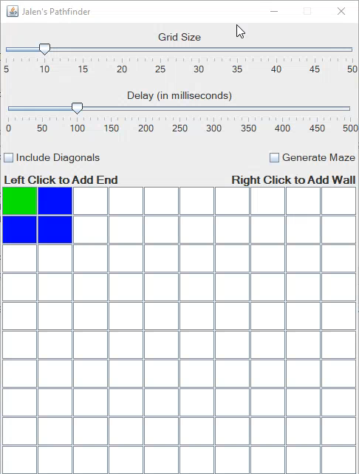
Invalid End Point
Valid = Not Blocked
Path has been found
Show Error
Red starting point
Red end point
Left Click on Empty Spot
Turns to Starting Point

Slide 8
Optional Steps
Adding or Removing Walls
Increasing or Decreasing the Grid Size
Increasing or Decreasing the Delay
Including Diagonals
Generating Mazes

Slide 9
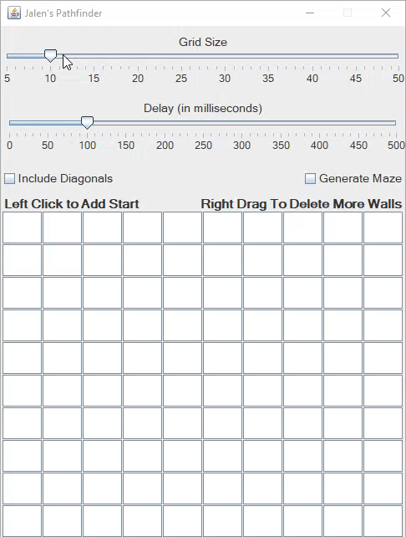
Adding or Removing Walls
Right Click on Empty Spot
Empty Spot Wall
Right Click on Wall
Wall Empty Spot
Holding Right Mouse After Click
Empty Spot Wall
Wall Empty Spot

Slide 10
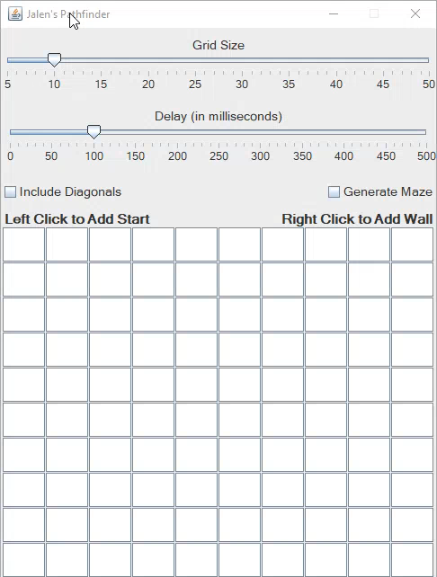
Increasing or Decreasing the Grid Size
Grid sizes range from…
5 rows & columns
50 rows & columns
Moving slider to
Left decreases grid size
Right increases grid size
Grid clears then resets once user stops dragging slider

Slide 11
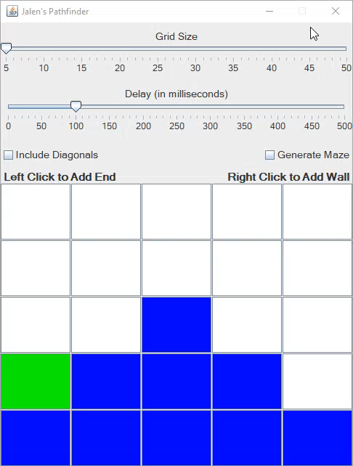
Increasing or Decreasing the Delay
Delay ranges from…
0 milliseconds
500 milliseconds
Moving slider to
Right slows down delay
Left speeds up delay
Delay sets once user stops dragging slider

Slide 12
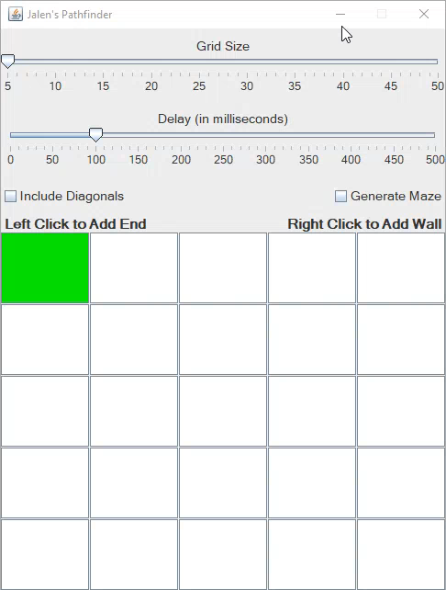
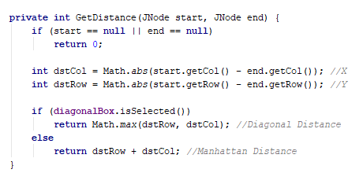
Including Diagonals
Unchecked
4-Way Movement
Manhattan Distance
Checked
8-Way Movement
Diagonal Distance
Manhattan vs. Diagonal

Slide 13
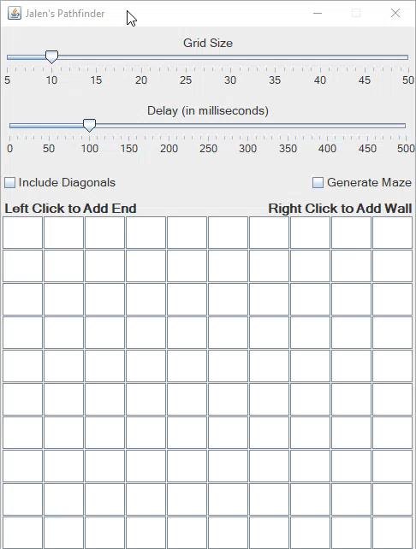
Generate Maze
After user checks it,
Grid is cleared
New walls generated into maze
While checked,
Clicking grid size slider generates new maze
Changing grid size generates new maze

Slide 14
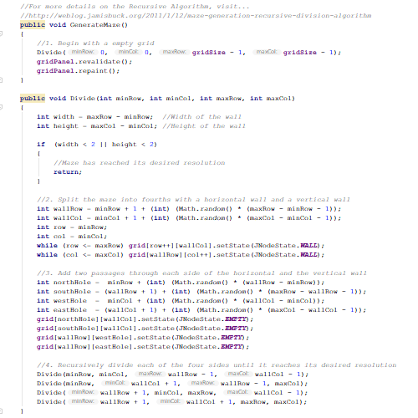
Generate Maze
How Does It Work?

Slide 15
Finding the Shortest Path Steps for A* Algorithm
Finding Node Closest to the End
Adding Neighbors of that Node for Evaluation
Construct the Path that was Found
Show Error if No Path is Found

Slide 16
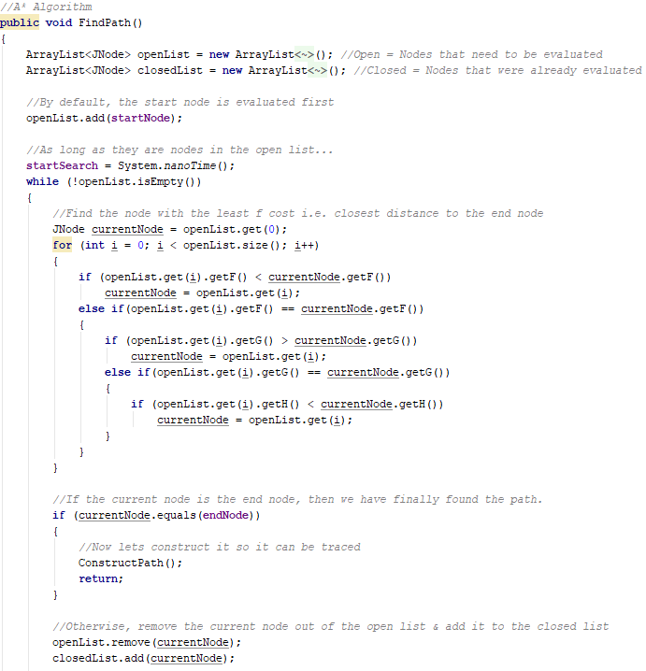
Finding Node Closest to the End

Slide 17
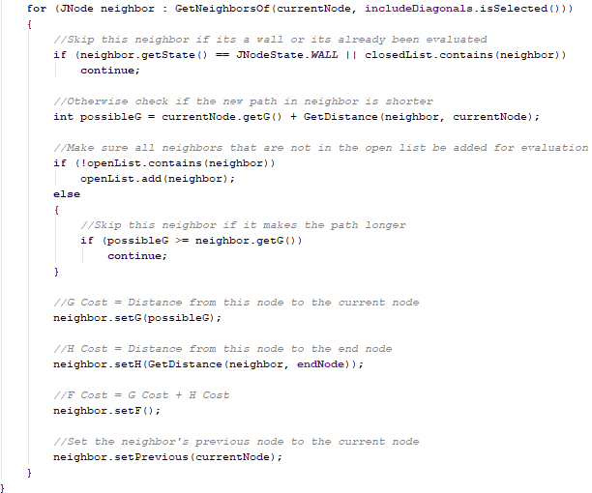
Adding Neighbors of that Node for Evaluation

Slide 18
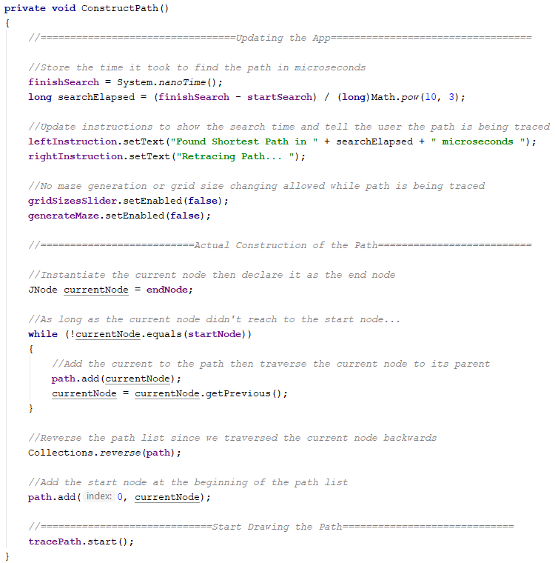
Construct the Path that was Found

Slide 19
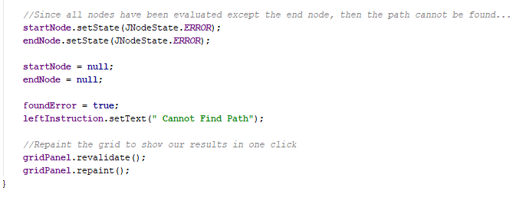
Show Error If No Paths Are Found

Slide 20
Any Questions?
Code: https://github.com/JayDiddyThaGOAT/PathFinder

Slide 21
Thank You For Listening

